Slide 1
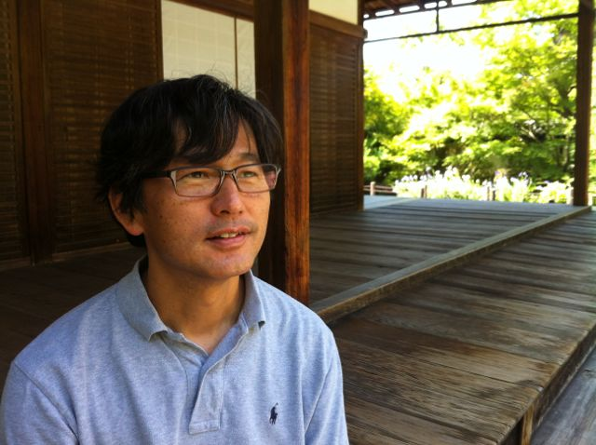
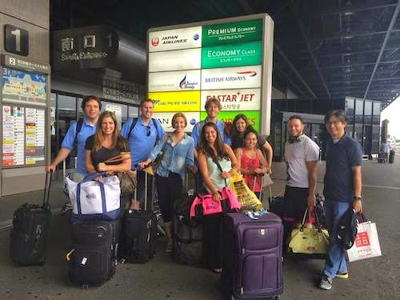
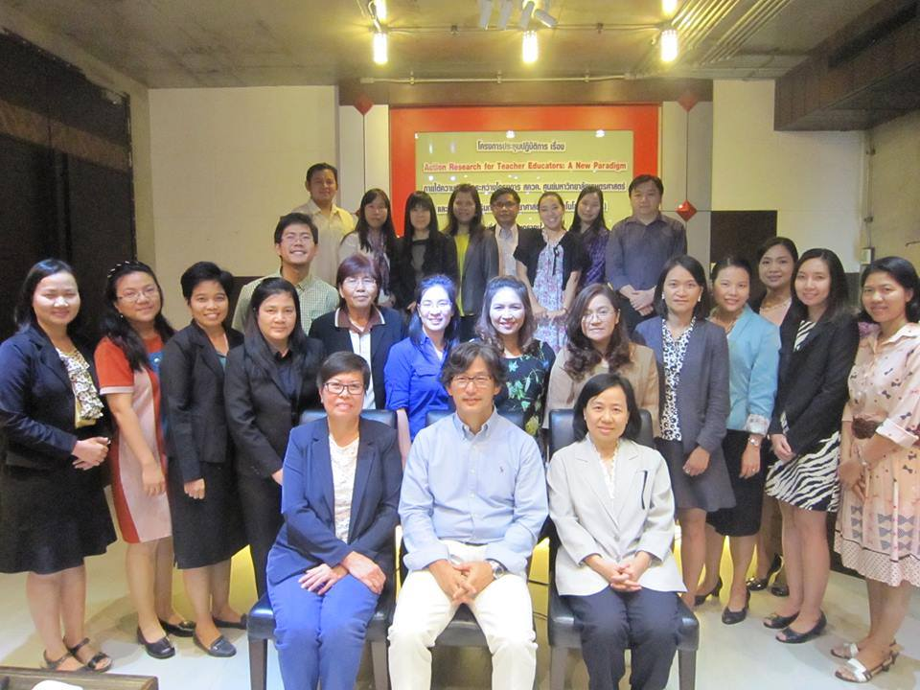
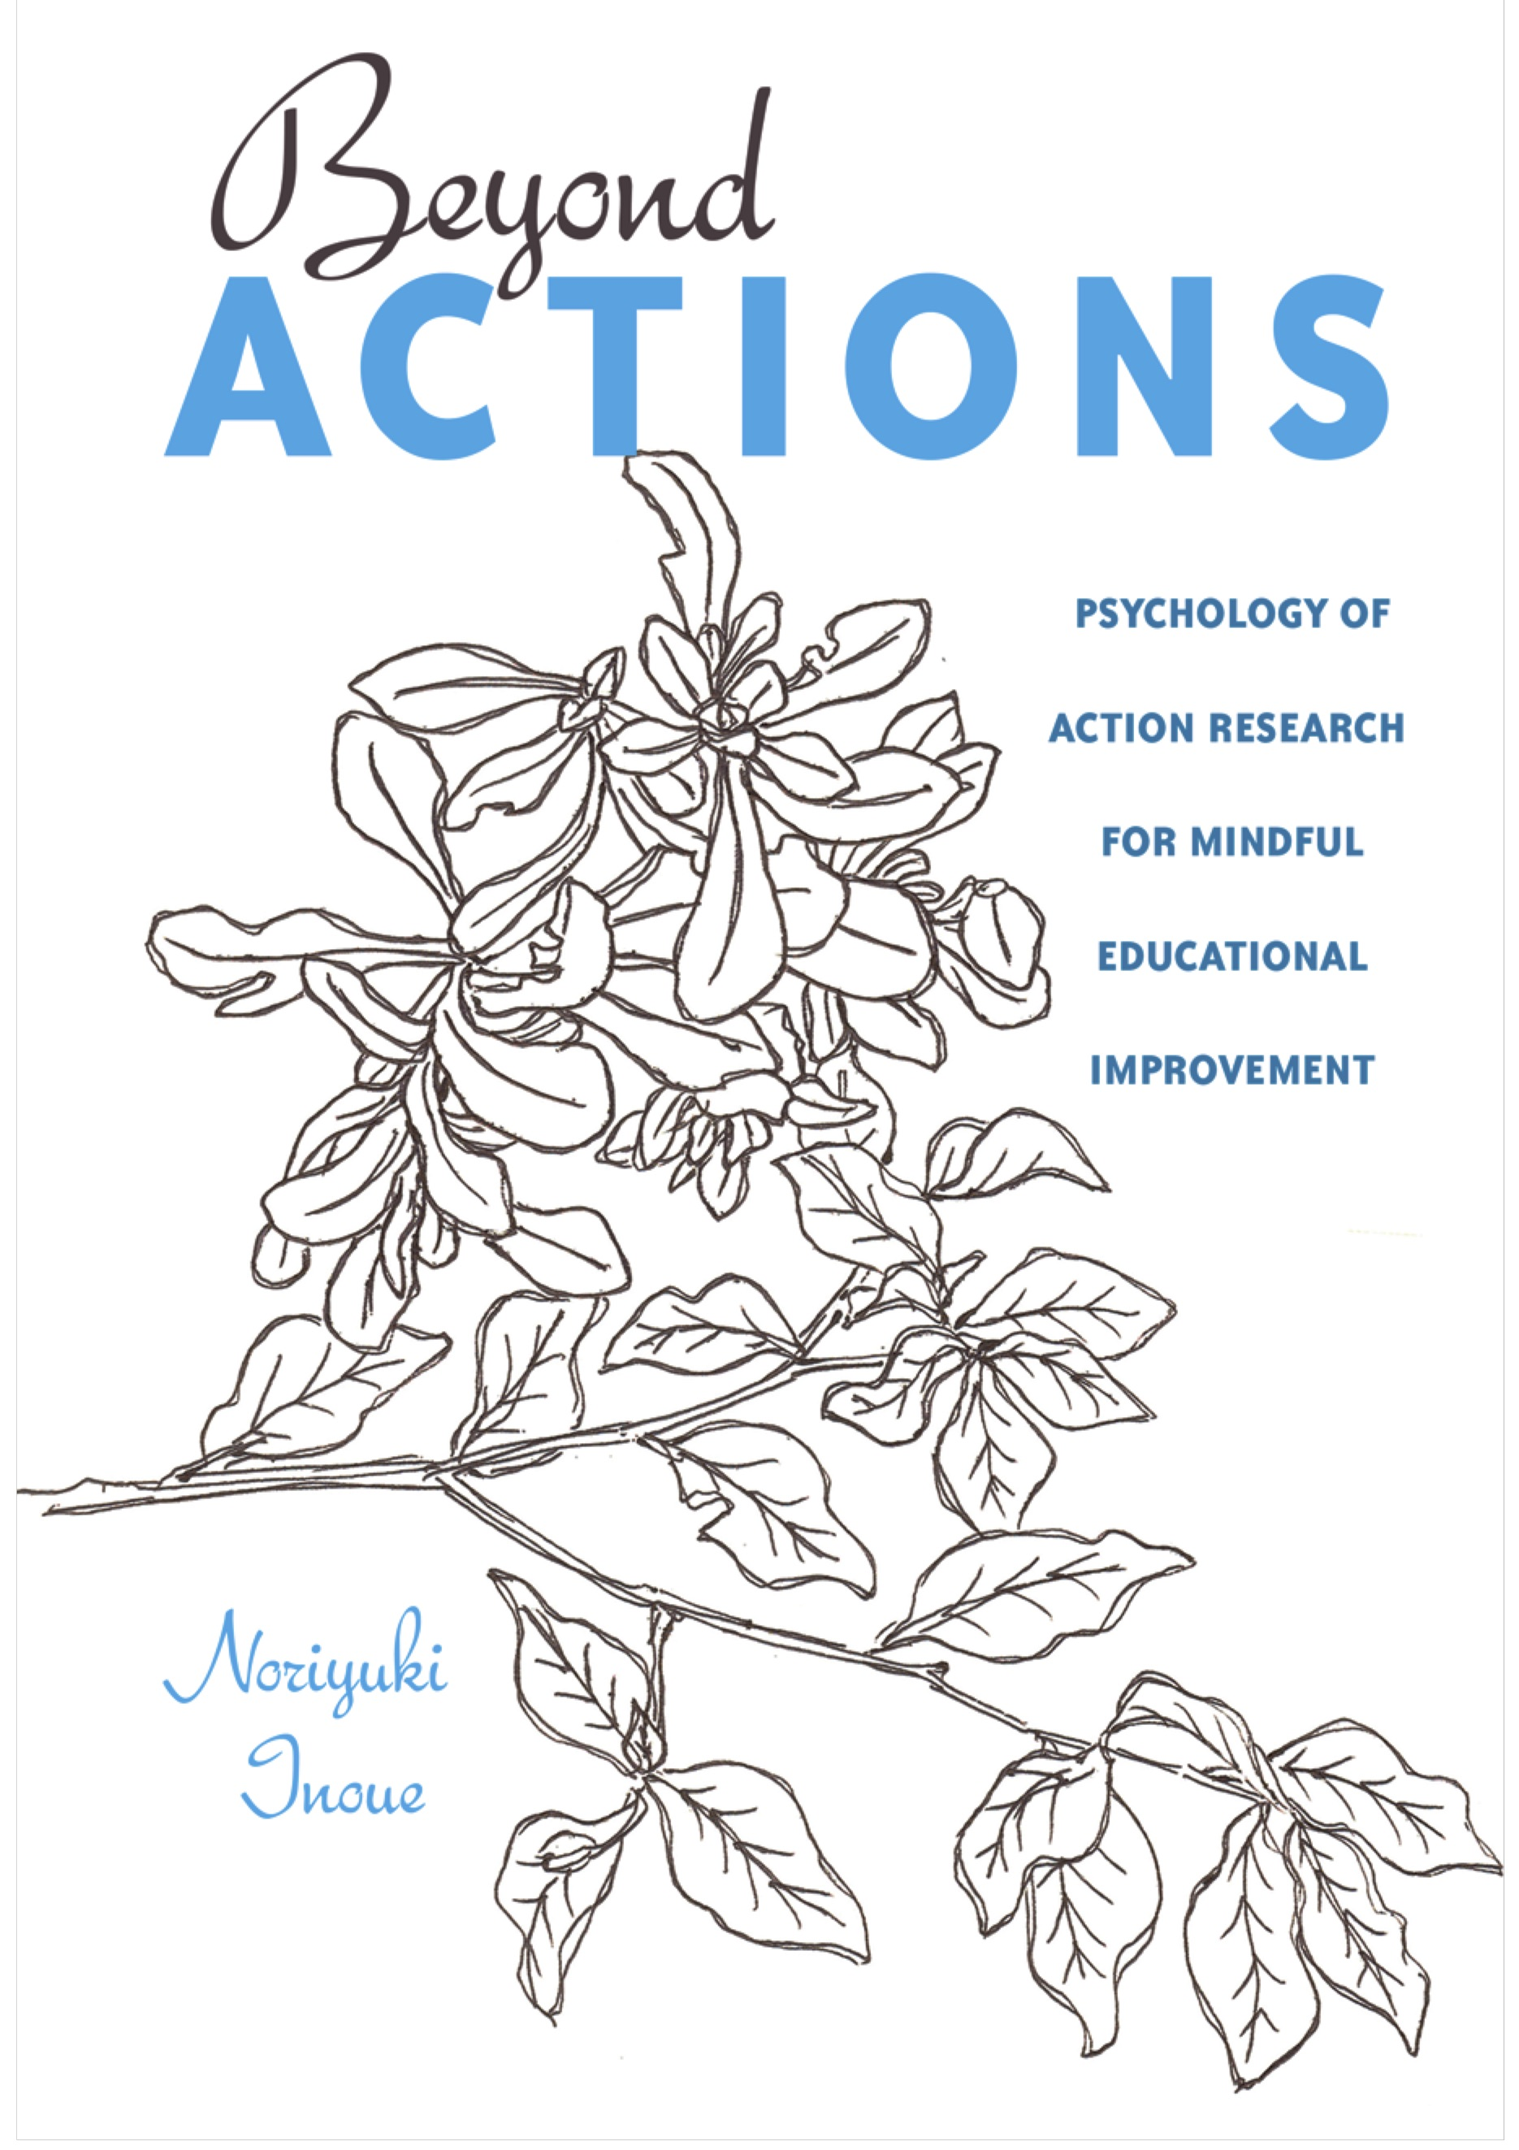
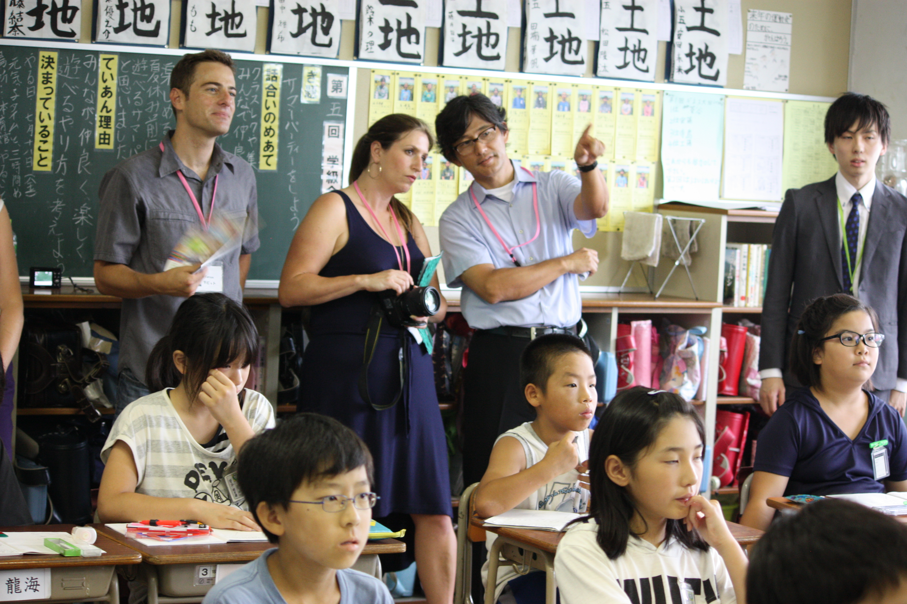
Noriyuki Inoue Waseda University http://ninoue.weebly.com/ My primary interest lies in Action Research x Culture, the cultural dimension of action research. Over the years, I came to learn how deeply our practice improvement efforts and decision making are grounded in the cultural context that often defines our epistemological stance, values, beliefs and ways to approach challenges and conflicts in the context. Having that perspective, I assume, will enrich our understanding of action research process. Recently, I have been writing about how cross-cultural exchanges in action research can unlock and promote previously unavailable types of learning and awareness, especially by introducing a variety of East Asian epistemological concepts. In you are interested, please check out the links below!
About myself: My specializations are in educational psychology and educational research methods. At Waseda University Faculty of Human Sciences, I teach educational psychology, educational system assessment and research seminars. My recent research focuses on teacher expertise development, action research, lesson study, non-Western educational epistemology, inquiry-based teaching, achievement motivation, real world problem solving and the development of mathematical thinking.
In Japan, I began my career as a mathematics teacher where I developed a variety of interests in human cognition and development. During these years, my initial interests in mathematics education evolved into an interest in advancing foundational knowledge of human cognition and development. I have been teaching and conducting a series of research at Waseda University after receiving graduate degrees and teaching teacher education courses as a faculty member at an U.S. university. I am now involved in advancing scholarship in the areas of action research and lesson study for teacher expertise development, and is conducting cross-cultural research incorporating East Asian cultural concepts and epistemology for mindful inquiries in professional development.
Video Message
Action Research Tokyo Program
2015 IPST Action Research Workshop in Bangkok
I would love to start new collaborations or conversations with you! If you are interested, please email me at n.inoue@waseda.jp.
Japanese Lesson Study Day

