Slide 1
Lesson Improvement and School Reform through Action Research in Canada
9th November, 2013
13:00-17:30
Mejiro Campus at JWU, Tokyo
Jackie Delong

Slide 2
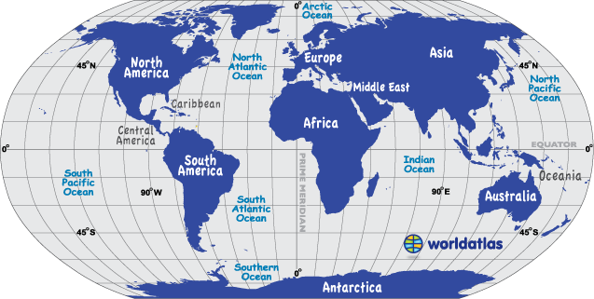
The World

Slide 3
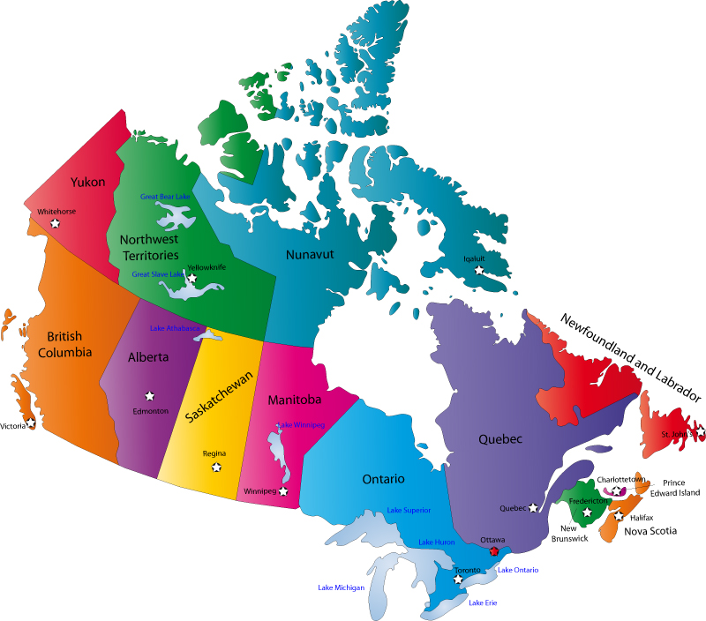

Slide 4
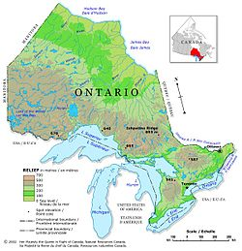
Ontario

Slide 5
A Living-Theory Action Research Methodology
Say what you want to improve.
Produce an action-plan on how you are going to improve it.
Act on your plan and gather the data you need to judge the effectiveness of your actions.
Judge your effectiveness (Evaluation).
Modify what you want to improve, modify your plan and modify your actions in response to your evaluations.
Produce a description and explanation for your own professional learning and test the validity of your explanation with others.

Slide 6
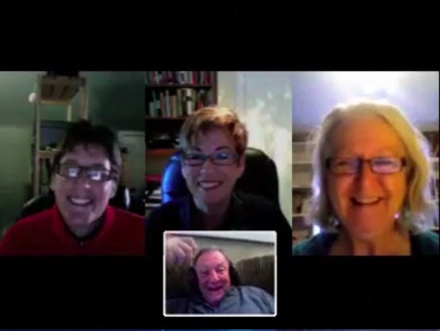
Energy-Flowing Values

Slide 7
Elementary Student Action Research

Slide 8
High School Student Action Research

Slide 9
Democratic evaluation for students and teachers in a Culture of Inquiry

Slide 10
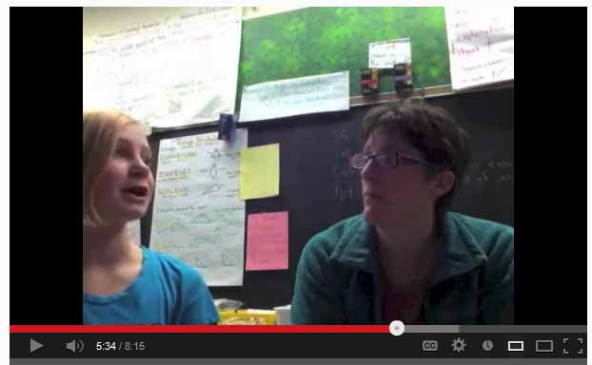
Cathy’s Democratic Evaluation

Slide 11
Action research as sustained, self-directed professional learning

Slide 12
Action Research: Influencing Systems

Slide 13
Action Research: Influencing Systems

Slide 14
Teachers share their learning in a culture of inquiry

Slide 15
Will you join me in Action Research?
http://www.spanglefish.com/actionresearchcanada/
Arigato

