Slide 1
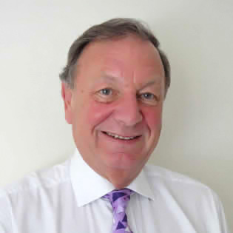
Living Theory Approach
Prof Jack Whitehead
University of Cumbria

Slide 2
Overview
The use of a Living Theory approach to Action Research
The use of multimodal narratives with digital technologies in workplace learning
International case studies

Slide 3
‘If an object exists as a living contradiction, what must the thought (statement about the object) by that expresses it?’
Ilyenkov’s (1977:p.313)

Slide 4
Overview
The use of a Living Theory approach to Action Research to:
raise capabilities, catalyse innovation and to lead research into workforce learning
facilitate the development of an effective, innovative and responsive CET sector

Slide 5
Living-educational-theory
… an individual’s explanation of their educational influences in their own learning, in the learning of others and in the learning of the social formations that influence the learning, to distinguish the explanations generated by practitioners from the explanations deduced from general theories and applied to individual cases.

Slide 6
‘How do I improve what I am doing?’
What do I want to improve?
Why do I want to improve it?
What will I do (action plan)?
What data will I collect?
Evaluating my effectiveness

Slide 7
Facilitate the development of an effective, innovative and responsive CET sector
http://www.actionresearch.net/living/living.shtml
Yvonne Crotty's Ph.D. (2012) Thesis, How am I bringing an educationally entrepreneurial spirit into higher education? Dublin City University, 2012. http://www.actionresearch.net/living/yvonnecrotty.shtml
Bonnie Kaplan's Master of Technology Dissertation, How do I use my living and lived experience to influence creative economic independence in others? 2013 Durban University of Technology. http://www.actionresearch.net/living/kaplan/KaplanMTech032014.pdf
Graham Van Tuyl's Ph.D. (2009) Thesis, From Engineer To Co-Creative Catalyst: An Inclusional And Transformational Journey. University of Bath. http://www.actionresearch.net/living/gvt.shtml

Slide 8
The use of multimodal narratives with digital technologies in workplace learning

Slide 9
International Case Studies
South Africa, China, Canada, India, Europe, Israel, Japan and Australia
http://www.actionresearch.net/living/living.shtml
http://www.actionresearch.net/writings/moira.shtml

Slide 10
Living Theory Approach
Prof Jack Whitehead
University of Cumbria

