Slide 1
Enhancing Professionalism with Living Educational Theory research
Jack Whitehead, University of Cumbria, UK.
Keynote to the first annual McGill School of Continuing Studies Conference on Action Research in Teaching, 22nd January 2021.

Slide 2
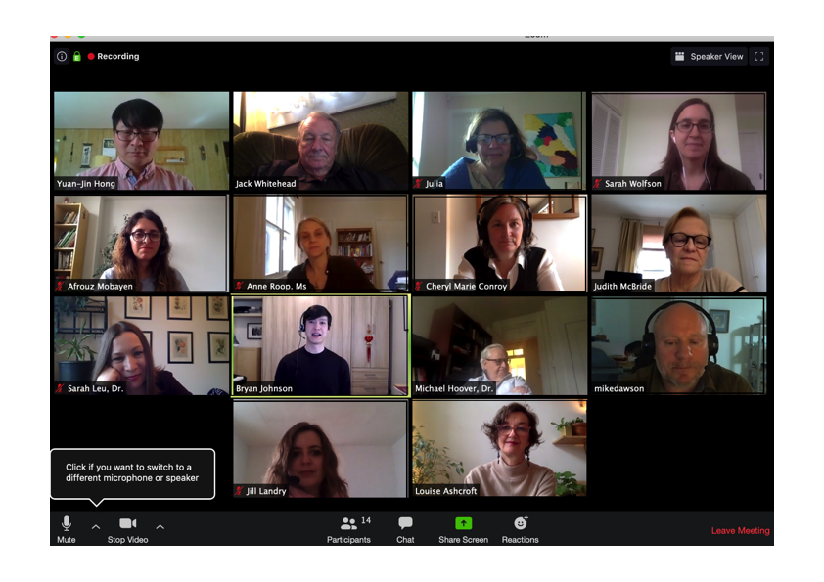
Pilot project 8th May 2020, McGill University

Slide 3
Presentations at the 1st Annual Conference on Action Research in Teaching 22 January 2021
Ellie Phillips Using the Inner Voice in second language learning.
Afrouz Mobayen How am I moving towards the inclusion of individuals with non-visible differences?
Louise Ashcroft A transformational journey: From narrative enquiry to reflective practices.
Commentary: Dr. Judy McBride
Michael Dawson Thinking, looking, and talking them over: Working out a new way of figuring out phrasal verbs.
Cheryl Conroy Understanding my students’ perspectives on accent and cultural identity to improve ESL learning.
Jill Landry and Louis-David Bibeau Hidden intersections in an online classroom: Encountering a side sequence with a critical friend
Julia Mercuri-Albisi How am I promoting a pedagogy of joy in my teacher practice?
Commentary: Dr. Michael Hoover

Slide 4
Values of Canadian Citizens
Canadian Charter of Rights and Freedoms :
fundamental freedoms, democratic rights
the right to live and seek employment anywhere in Canada
legal rights (life, liberty and personal security)
equality rights for all
the official languages of Canada
minority language education rights
Canada's multicultural heritage
Indigenous peoples’ rights
https://www.canada.ca/en/canadian-heritage/services/how-rights-protected/guide-canadian-charter-rights-freedoms.html

Slide 5
CRITERIA OF PROFESSIONALISM
A Long Period Of Specialized Training.
A Broad Range Of Autonomy For Both The Individual Practitioners And For The Occupational Group As A Whole.
An Acceptance By The Practitioners Of Broad Personal Responsibility For Judgments Made And Acts Performed Within The Scope Of Professional Autonomy.
A Comprehensive Self-Governing Organization Of Practitioners.
Making A Contribution To The Professional Knowledge-Base. This Definition Is Supported By My Co-Presenters In Symposium Presentations At The 2020 International Professional Development Association Conference (Mounter, 2020; Huxtable, 2020; Colman, 2020a&B ).
The Expression Of Educational Responsibility In Living Educational Theory Research To Enhance One’s Own Professionalism In One’s Continuing Professional Development In Contributing Their Living-Educational-Theory To The Professional Knowledge-Base (Colman, 2020a & B; Mounter, 2020; Huxtable, 2020; Whitehead, 2020a & B).

Slide 6
A living-educational-theory
A living-educational-theory is an individual’s explanation of their educational influences in their own learning, in the learning of others and in the learning of the social formations that influence their practice and understandings.
Whitehead, J. (2019) Creating a living-educational-theory from questions of the kind, ‘how do I improve my practice?’ 30 years on with Living Theory research. Educational Journal of Living Theories, 12(2); 1-19. Retrieved 14 January 2021 from https://www.actionresearch.net/writings/jack/jwejolts2019.pdf

Slide 7
Living Educational Theory research
Living Educational Theory research offers an approach to continual professional development that enables the educator to enhance their own professional practice and also enables them to offer as gifts the knowledge, expertise and talents they develop to extend the knowledge base of the profession. In this paper we briefly introduce Living-Theory research and the international CPD project, ‘Living Values Improving Practice Cooperatively’ that began in the process of supporting educators through a Masters programme.
Whitehead, J. & Huxtable, M. (2013) Living educational theory research as transformational continuing professional development, Gifted Education International 29(3); 221-227
https://www.actionresearch.net/writings/jack/jwmhGEIarticle141012.pdf

Slide 8
Educational Action Research in Teaching– Action Planner
Using Action-Reflection Cycles from Action Research in questions of the kind, ‘How do I improve what I am doing in my professional practice?’?
What are your reasons for your concern?
What might you do to improve your practice?
How will you know that your practice has improved?
How are you going to find out? ie;
What kind of data will you need to collect to enable you to make a judgement on the outcomes of your practice in terms of the quality of your own or teachers' and/or pupils' learning?
What kind of resources will you need to enable you to implement your plan?
Which colleagues might you ask to join a validation group of some 3-8 individuals to help you to strengthen the validity of your draft evidence-based explanation of your educational influences in your own learning and in the learning of others.
Action-research Living Educational Theory Planner
http://www.actionresearch.net/writings/jack/arlivingtheoryplanner.pdf

Slide 9
Educational Action Research in Teaching– Explaining educational influences in learning
Improving our educational influences in learning, as teachers, educators and teacher educators includes our educational influences in the learning of our students. Hence the importance of producing a valid, evidence-based explanation of our educational influences in the learning of our students. The focus on validity is important and this can be strengthened by subjecting our explanations to the mutual rational control of critical discussion (Popper, 1975, p. 44) in validation groups.
Popper, K. (1975) The Logic of Scientific Discovery, London; Hutchinson & Co.

Slide 10
Introduction to Action Research: Self-Directed Professional Development Pilot: Live Online Mini-Conference 8th May 2020 – Jack Whitehead’s response 9th May 2020
https://www.actionresearch.net/writings/mcgill/mcgill080520jwreponse.pdf
If you download the recording of the session onto your hard drive and move the cursor backwards and forwards I think that you will appreciate the significance of this multi-media form of representation for communicating the importance of the relational dynamic of your communications and relationships in explanations of your educational influences in learning on this programme.

Slide 11
Introduction to Action Research: Self-Directed Professional Development Pilot: Live Online Mini-Conference 8th May 2020 – Jack Whitehead’s 2nd response 18 May 2020
http://www.actionresearch.net/writings/mcgill/jwmcgill180520from8may.pdf
As I listen to and watch your presentations again I feel that you all expressing what I call a ‘life affirming energy with values of human flourishing’. As I see myself in the group videos I experience myself existing within a network of relationships that flows with this ‘life affirming energy with values of human flourishing’. As your research, into your professional development, continues you may enjoy clarifying to yourself and each other the unique constellations of values that you use to explain your educational influences in your own learning and in the learning of others. For example you could see how Judy describes her value of a relational métissage of solitude, intimacy, and community, and the liminal spaces between, in her living-poster at https://www.actionresearch.net/writings/posters/judy20.pdf.
You might also enjoy accessing the 2020 homepage of living-posters at https://www.actionresearch.net/writings/posters/homepage2020.pdf and creating an individual and/or group poster to add to the 2020 homepage.

Slide 12
Locating your action research and living-educational-theories within a global social movement with values of human flourishing. Page One
Giguere, L., MacLeod, L. & McBride, J. (2019) The Transformative Possibility of Literary Métissage: An action research Report. Action Learning Action Research journal, 25 (1) (2019) 31-64.
Campbell, E. (2018) How has love influenced me as a teacher researcher, and learner? A narrative inquiry into a teacher's abrupt awakenings. PhD Thesis, Nipissing University, Canada. Retrieved 13 January 2021 from https://www.actionresearch.net/living/campbellphd/campbellphd2018.pdf

Slide 13
Locating your action research and living-educational-theories within a global social movement with values of human flourishing. Page Two
Whitehead, J. (2020) Contributing to moving action research to activism with Living Theory research. Canadian Journal of Action Research, 20(3) 55-73. Retrieved 13 January 2021 from https://journals.nipissingu.ca/index.php/cjar/article/view/467
Whitehead, J. (2005) Living inclusional values in educational standards of practice and judgement. Keynote for the Act, Reflect, Revise III Conference, Brantford Ontario. 11th November 2005. Ontario Action Researcher, 8(2). Retrieved 13 January 2021 from
http://oar.nipissingu.ca/PDFS/V821E.pdf
Whitehead, J. (2000) Creating our own knowledge. Keynote presentation to the Act, Reflect, Revise 1V Conference, Brantford, Ontario. Retrieved 13 January 2021 from
http://www.bath.ac.uk/~edsajw/writings/keyarr.pdf
Delong, J. & Whitehead, J. (1998) Continuously regenerating developmental standards of practice in teacher education: A cautionary note for the Ontario College of Teachers. Ontario Action Researcher, 1(1) Retrieved 13 January 2021 from
http://oar.nipissingu.ca/archive-Vol1-V113E.htm

