Slide 1
Developing international Scholarship of Teaching and Learning with Living Educational Theory Research
Jack Whitehead,
University of Cumbria, UK and North-West University, South Africa. For presentation at the 2023 Conference of the International Society for the Scholarship of Teaching and Learning (SoTL) at Utrecht University 8-11th November, 2023

Slide 2
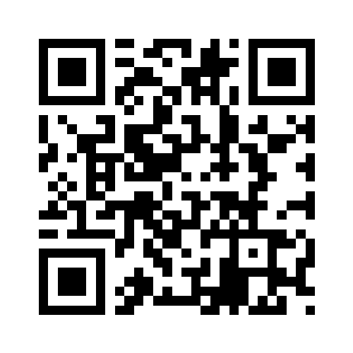
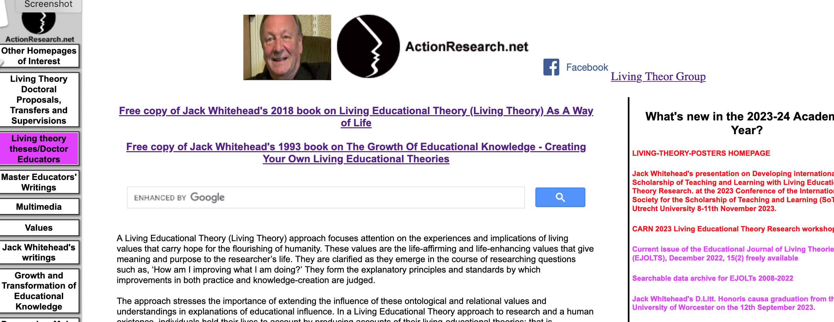
Living Educational Theory Research
https://actionresearch.net/
A defining characteristic of Living Educational Theory Research is that a practitioner-researcher creates and shares a values-based explanation of their educational influence in their own learning, in the learning of others and in the learning of the social formations within which the practice is located.
Whitehead, J. & Huxtable, M. (2023): Why a focus on ‘what is educational?’ matters so much in reconstructing education?, Irish Educational Studies.

Slide 3
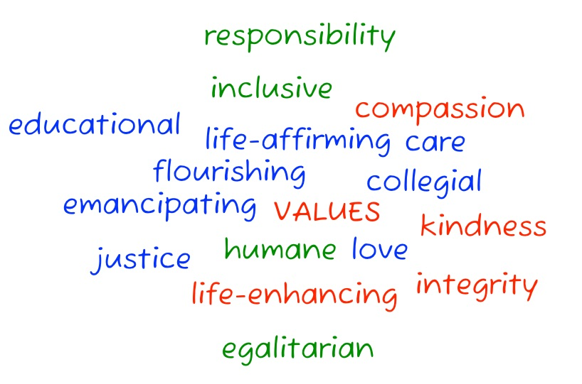
A Scholarship of Teaching and Learning - the need for a new epistemology emerging from Living Educational Theory Research
Educational Values in SoTL
The educational values in my scholarship of teaching and learning are being clarified and communicated with digital visual data my educational practice, with the use of a method of empathetic resonance.
Whitehead, J. & Huxtable, M. (2023) Improving the scholarship of teaching and learning in higher education. Workshop at the SOLSTICE/CTL Conference, Edge Hill University. https://www.actionresearch.net/writings/jack/jwmhedgehillworkshop140623.pdf

Slide 4
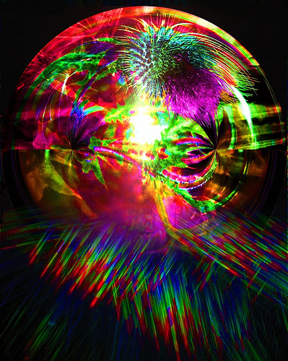
Creating a new ‘Collective Imaginary’ for a Scholarship of Teaching and Learning (SoTL) with values of human flourishing
‘Collective imaginary’ our collective ability to create social reality is perhaps out most defining human capacity… an emergent property of the complex self-organisation of many minds with the capacity for symbolic language.

Slide 5
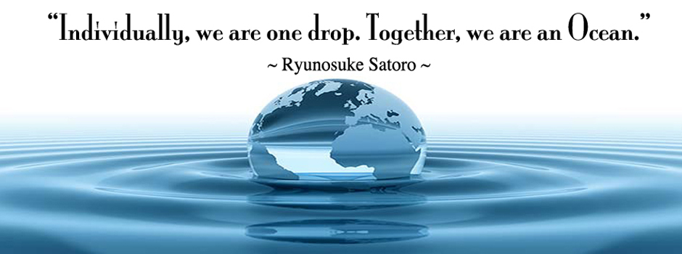
Creating a new Collective Imaginary with Living Educational Theory Research to bring into being a world with values of human flourishing
Benefit from… papers, doctorates, books, resources freely accessible from https://actionresearch.net/
Contribute to the creation of a new Collective Imaginary with values of human flourishing by sending your living-poster to jack@livingtheory.org
https://www.actionresearch.net/writings/posters/homepage2023.pdf

