Slide 1

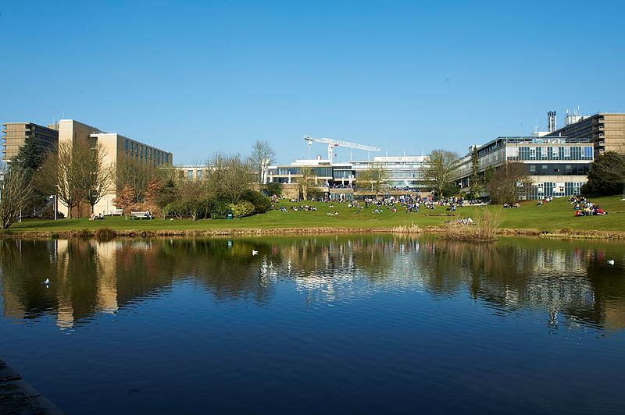
C21st Chaplaincy in a Secular Institution.
©Nic Delves-Broughton University of Bath

Slide 2


Welcome to the Chaplaincy!
Support and Care, Space and Prayer in the Heart of the Campus

Slide 3

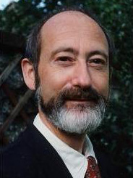

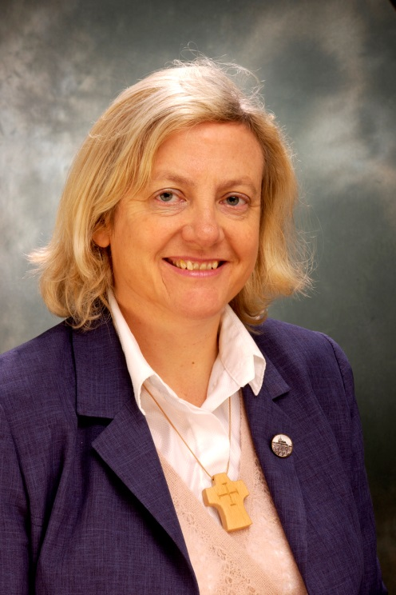
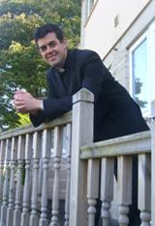
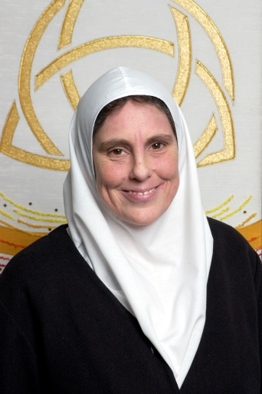
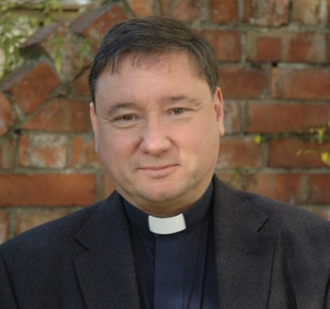
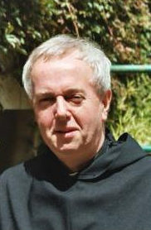
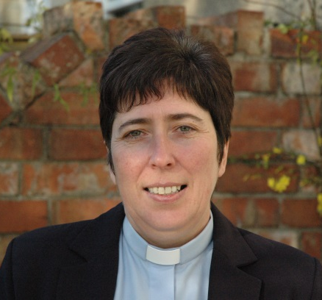
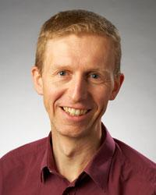
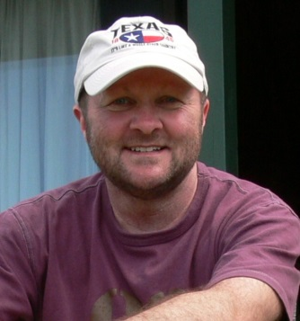
The Chaplaincy Team
Mother Sarah
(Orthodox)
Dan
(Chaplaincy
Assistant)
Barry
(Anglican)
Angela
(University Chaplain)
Andrew (Methodist)
David (U.R.C)
Fr Bill (R.C)
Gordon (Chair )
Kieren
(Asst. URC)
Helen (U.R.C)

Slide 4
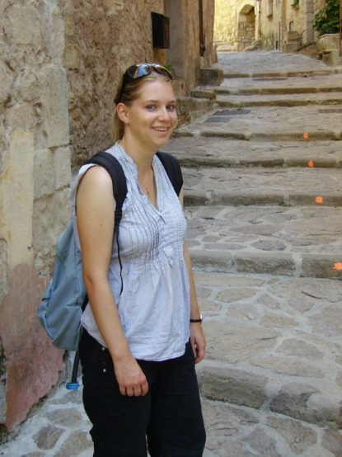
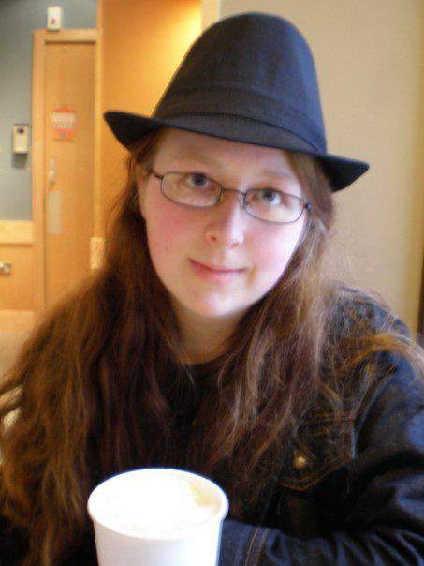
Chaplaincy Assistants
Linking into the heart of student life
Chaplaincy assistants are bridges between Chaplains (9) and students (16,000, 30% of whom are Internationals)

Slide 5
Mission Statement
1) To serve the spiritual and religious needs of the University Community
2) To provide pastoral care and friendship for all staff and students of the University
3) To enhance the learning experience through exploration of faith, peace and justice issues.

Slide 6
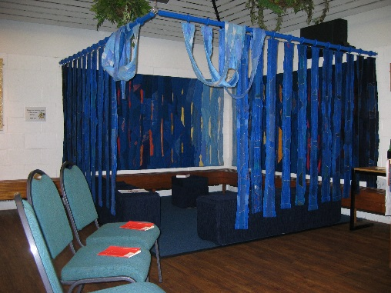
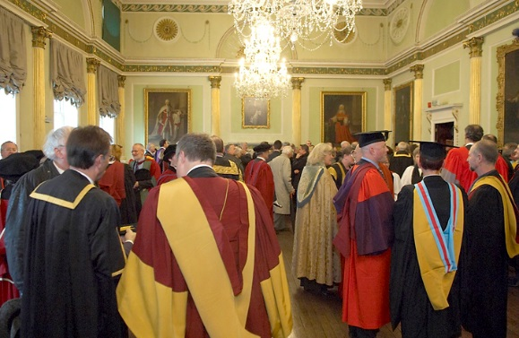
Strategic Areas
Worship
Pilgrimage
Public Profile within the Institution
Pastoral Provision for both students and staff
Reaching out
Interfaith relations
Student life
  Freshers Week
  International Students
  Hospitality
Staff work

Slide 7
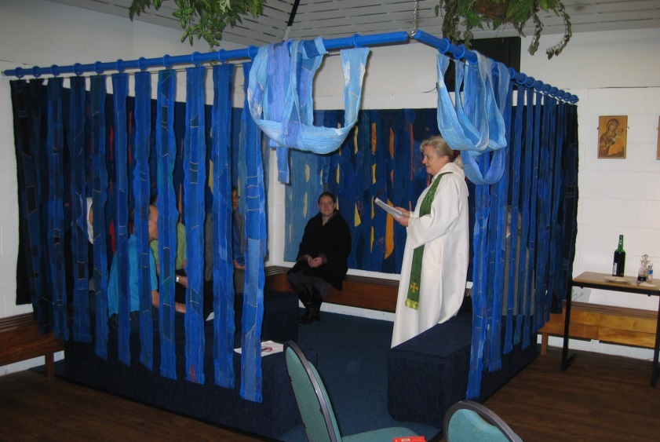
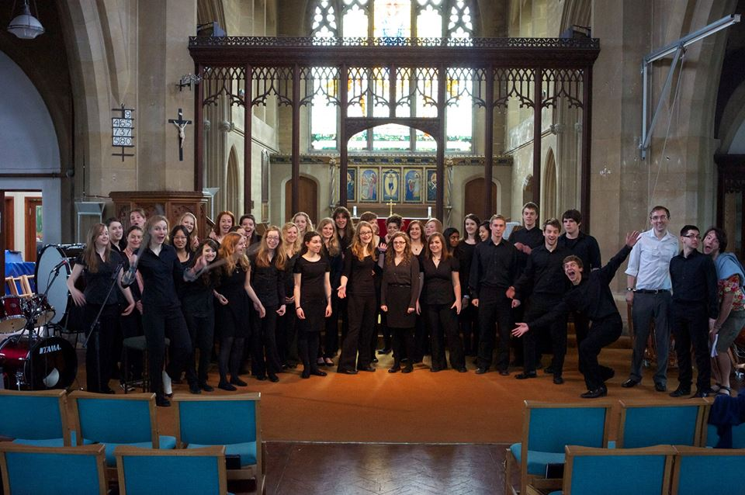
Worship
Putting prayer at the heart of the University community…
The Chaplaincy provides a space for the daily CU prayer meeting
We organise and lead a Midweek Eucharist
Mid day prayers 2/week
Sunday Mass - Friday Rosary - Lectio Divina
Memorial services after student/staff deaths
Orthodox prayers
Private prayer space
Praying with people
Designed by a local artist, the prayer corner provides a more private setting for prayer and reflection
GASP Choir rehearses in the Chaplaincy

Slide 8
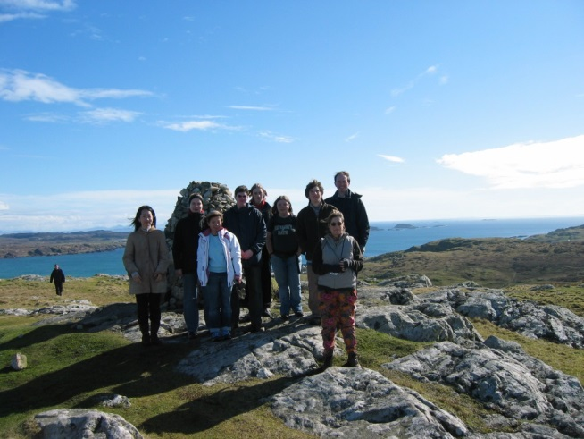
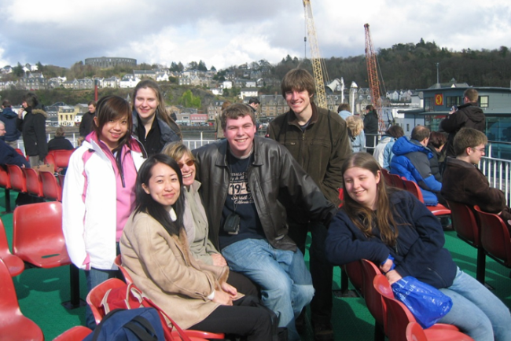
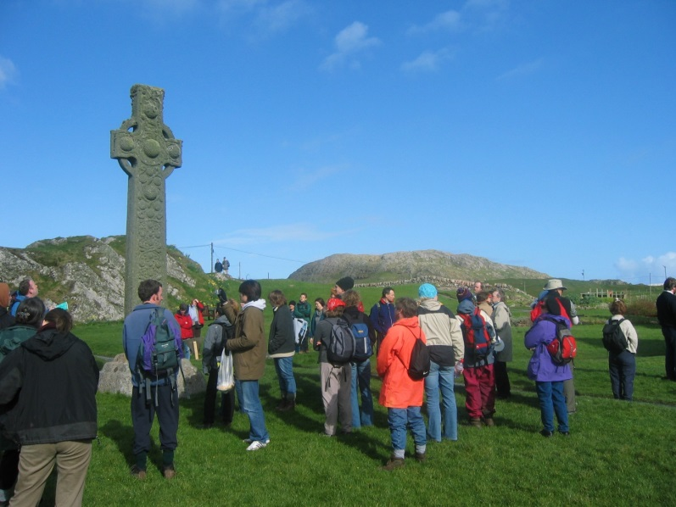
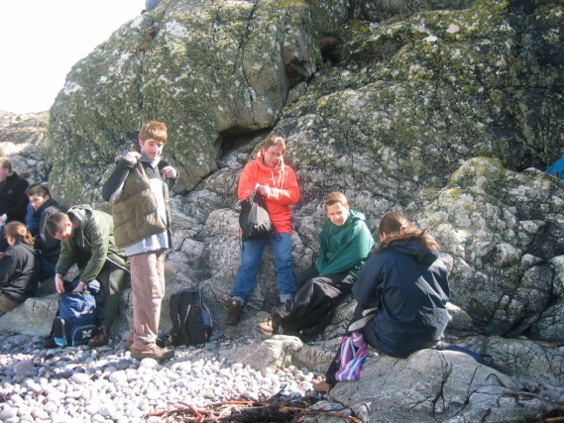
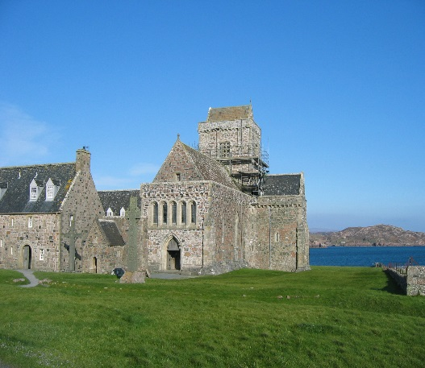
Pilgrimage
Helping students to expand their religious horizons e.g.
by attending Student Week on Iona
The journey is part of the pilgrimage

Slide 9
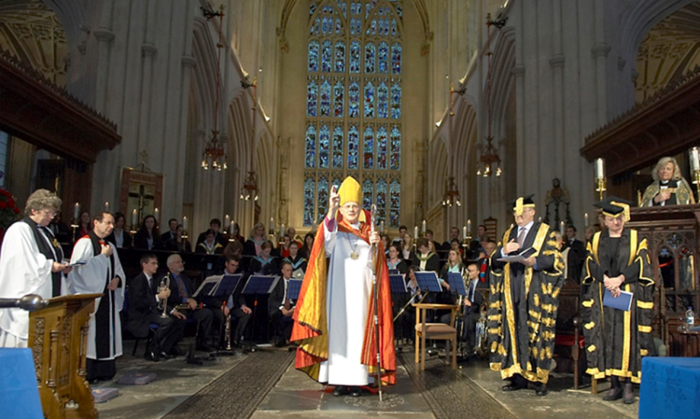
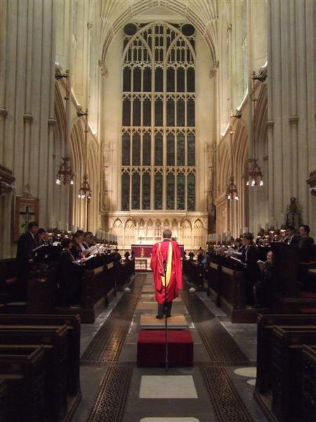
Public Profile
The Chaplains team organises the annual Carol Service in Bath Abbey
Involvement in special events – eg 50th anniversary of foundation of the University in 2016/17
The University likes to have a chaplain present at each of the 19 Graduation Ceremonies
University Chaplain invited to the Installation of new Chancellor, Founder’s Day events, Chancellor’s Dinner in Graduation week
Take part in Public Debates
We are part of Student Services
LEFT: University Chamber Choir rehearsing for the annual carol service
FAR RIGHT: 40th anniversary celebration

Slide 10

Pastoral Provision
We work alongside the Counselling team in Student Services. 1:1 Listening
Frequent cross referencing from the mental health team
Provision of bereavement counselling by the Chaplains
Pastoral Counselling and Advice giving if sought
Helping students to identify vocations – walk alongside
The University Chaplain is one of the first to be notified in the event of a sudden death of student
Meet with families when they come to visit
Set up with Student Services immediate help session for bereaved flat mates/course mates
Planning memorial events with student friends & family

Slide 11

Reaching Out
The Chaplaincy organises…
Public lectures on faith matters
Seminars - Recently on Gender based Abuse
Exhibitions
e.g. The Forgiveness Project
Holocaust Memorial Exhibition
Peace vigils on the Parade
Weekly Oxfam lunches
Organised a Debate on ‘What is Blasphemy’ 2 weeks ago following on from the Charlie Hebdo tragedy

Slide 12
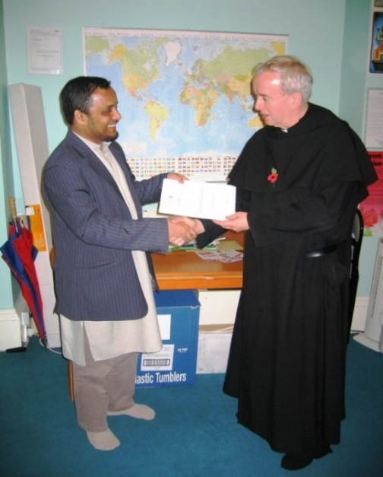
Interfaith relations
The Chaplaincy provides a space for : The Jewish society’s Shabbat meal on Friday evenings
The University chaplain is the contact person for any practical problems with the Islamic prayer rooms
Diwali celebration held in Chapel
Buddhist meditation group meets in Chapel
Chaplaincy organises an annual
3 Faith Forum with speakers from Judaism,
Christianity and Islam
Father Bill and Imam Rashad

Slide 13
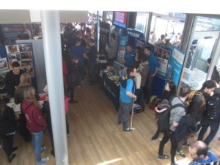

Student Life
Many different Christian student societies are
based at the Chaplaincy Centre:
Cath Soc
BANG! (Bath Anglicans)
Christian Union
Chinese Overseas Christian Fellowship (Mandarin speaking)
Cantonese Christian Fellowship
Love Bath student group
Other student societies also use the space
Vegetarian Society
GASP Gospel Choir
1001 Nights Society
Chaos Orchestra
many other groups
The Chaplaincy provides a social space and a safe space for students to meet and relax in the middle of a very pressured life
“One of the only places in the University where I don’t feel I am being judged.”

Slide 14
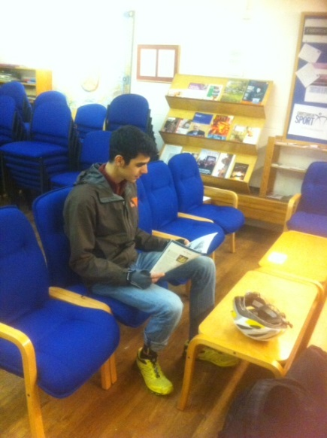
Freshers’ Week
The Chaplaincy provides:
Chaplaincy Stall @ Freshers’ Fair
Homesickness Group
Big Breakfast
1:1 Counselling
Drop in Centre
Tea and Toast nightly from 11.00pm-3.00am
Church Search Breakfasts
Phone number for concerned parents

Slide 15
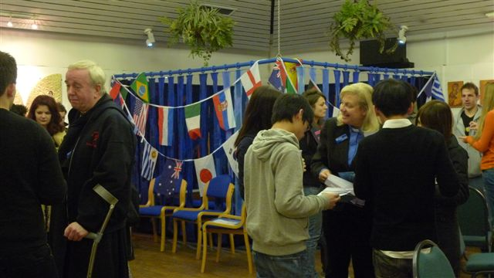
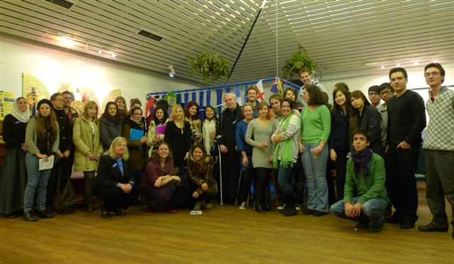
Welcoming international students
Providing a special welcome for Chinese students
Providing tailored pastoral care
Acting as a signpost to other services
A link between the University and life in the city of Bath – particularly local churches

Slide 16
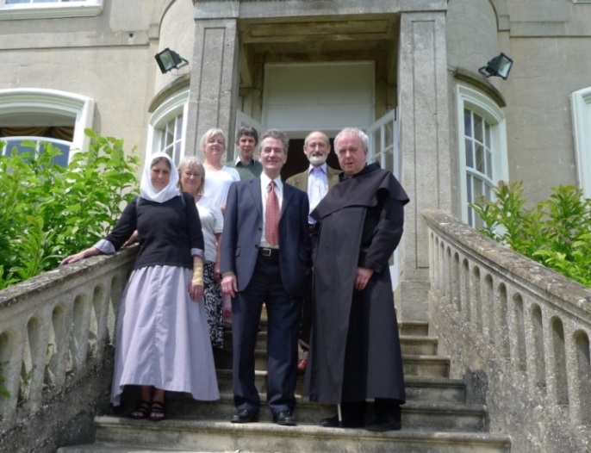
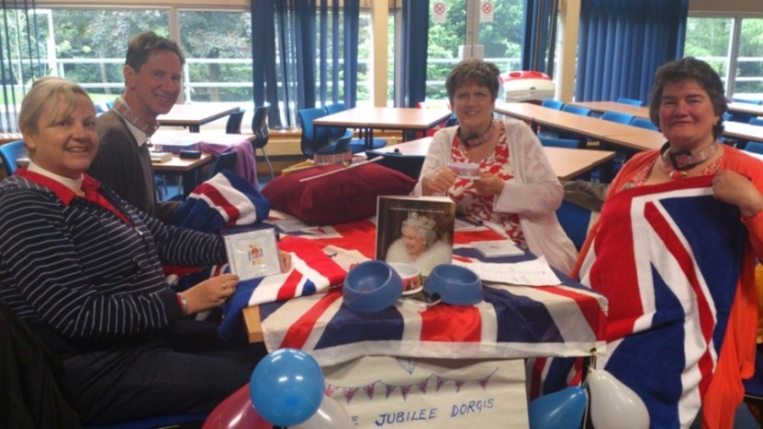
Organising the Queen’s Jubilee quiz for University Staff
Responding to the needs of our 2,500 staff
University closes Senior Common Room & Staff Association building
A new Staff Society formed – University Chaplain on the committee
The Chaplain is 1 of the leaders for the staff womens walks @ lunch
Among other social activities we organise quizzes, cultural trips etc
Formerly served on ethics committee of school for health
The Chaplaincy is available for staff groups to use
e.g Staff & PG Alcoholics Anonymous group
The DVC meets with the chaplains
at their annual away day.

Slide 17




Hospitality
Coffee/tea on the boil @ all times
Weekly Oxfam lunch
Globe café – free weekly lunch for international students organised by the Christian Union
Freshers events including the Big Breakfast
Pancakes on Shrove Tuesday
Leavers lunch
Veggie Suppers
Summer BBQ for Resident Tutors and Student Union Sabbatical Officers in Chaplains Garden

Slide 18





Oxfam Lunch
In the Chaplaincy
Tuesdays, 12.45pm to 1.45pm
Low prices
Vegetarian Soup – Bread – Cheese – Doughnuts
All welcome
all proceeds to

Slide 19

Challenges of Chaplaincy
Showing that Christianity is still relevant in a very pick-and-mix, multi-cultural environment
Getting known within the Institution
Attracting people to the Chaplaincy Centre
Reaching out to the people who really need us
Ensuring we are available at crises points : – freshers week, exam time, after sudden death
Speaking truth to power
Keeping ethics in science
Resisting ‘tick box’ mentality
Coping with hostility from atheists
Irrelevance of denominationalism
Being understood by parish clergy

Slide 20

Conclusion
Chaplaincy is not a church but a signpost to God through provision of: - - spiritual care
- pastoral welfare
- hospitality and welcome
- outreach
Chaplaincy is at the coal face of mission
By what we do, we take the Gospel to the people, not vice versa
Huge importance of having a visible witness at the heart of a very secular university e.g. ensuring that ethical issues don’t get lost in the excitement of scientific discovery
Chaplaincy provides a challenge to the Churches
- how can we learn from each other more?

