Slide 1
Virtual Annual Meeting- 2021 Accepting Educational Responsibility: Building Living Theory Cultures of Educational Inquiry in a Indian/global context
April 10th, 2021 Saturday
Shivani Mishra
Director, Department of Social Work,
Sardar Patel University, Vallabh Vidyanagar,
Gujarat, INDIA

Slide 2
1.
Objectives

Slide 3
The objective is to show how a Living Educational Theory research approach to action research using life skills education, can upscale the quality of education, in a rural preschool in Gujarat, India.

Slide 4
2
Perspectives and Theoretical Framework

Slide 5
Integrated Child Development Scheme- (ICDS) Welfare Service for Children in India
World’s largest community based program.
Launched on 2 October 1975, the scheme has completed 43 years of its operational age.
Preschool education in rural India is imparted through ICDS, which has emerged as the most extensive program for early childhood development.
…But, ICDS is lagging in imparting quality education to preschool children.

Slide 6
3
Accepting Educational Responsibility

Slide 7
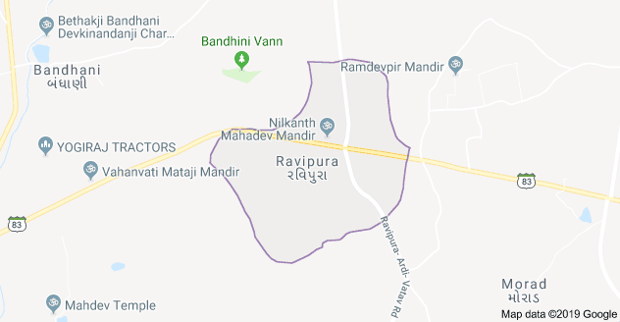
Study Site
The village has a population of 1460 and total number of houses is 301.
The total literacy rate as per Census 2011 is 65.8 % .
The sex ratio as per 2011 census, there are 957 females per 1000 male in village.

Slide 8
There are two Aanganvadi/ Preschool in the village:
Government aided &
privately-owned.
The villagers have been battling two major issues which becomes barriers in their development:
Child Marriage and Alcoholism.

Slide 9
Found a gap between:
children’s learning
teacher’s teaching
in the preschool children.

Slide 10
Framework
Quality of Education
Encourage
through
Life Skill Education

Slide 11
3
Methods, techniques, or modes of inquiry

Slide 12
The methods used are those developed by Rawal (2012; 2020) in life-skills education.

Slide 13
4
Results

Slide 14
The results include evidence of learning from a 72 hour programme of training in life skills education to understand and to teach it.
The results include an evidence-based explanation of how I link my practice with theory and theory with practice. They include an explanation of my learning how to take risk and realising how risk-taking as an important aspect of creative thinking in the generation of a living-educational-theory.

Slide 15
5
Significance

Slide 16
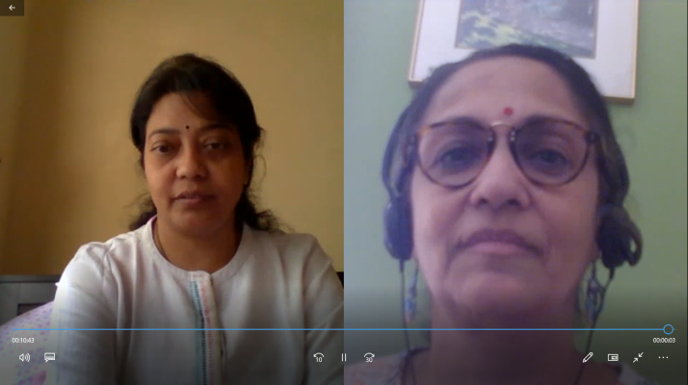
How can we individually and collectively demonstrate greater care about what happens in our society and in educational institutions?
My culture of inquiry(Delong, 2015) where I welcomed the climate of trust of preschool children and validation by my colleagues, my mentor Swaroop Rawal

Slide 17
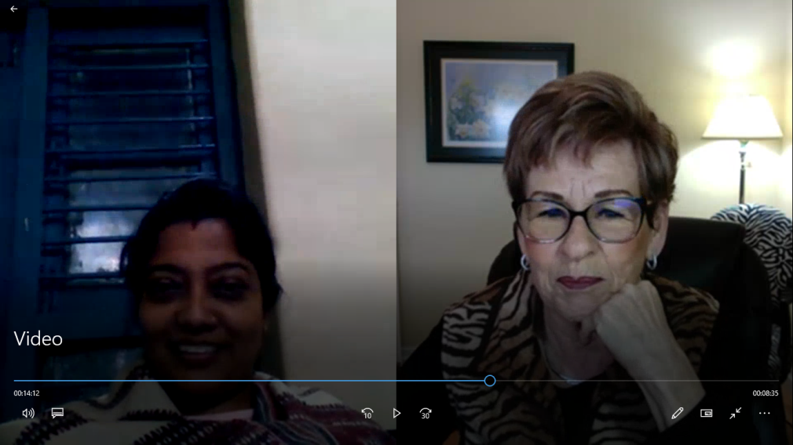
How can we individually and collectively demonstrate greater care about what happens in our society and in educational institutions?
Jackie Delong, a person who helped me to work on to understand my culture of inquiry. It is democratic process we have worked on to have more understanding of the theory as well as thoughts.

Slide 18
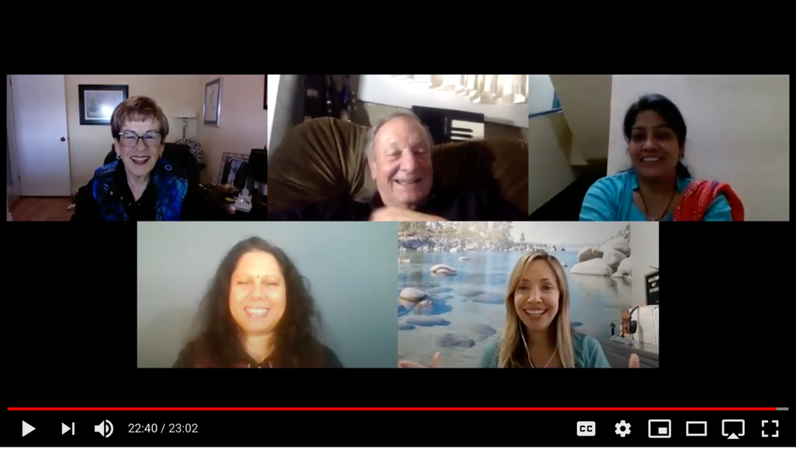
How can we unite with practitioners, with scholars across other academic fields and disciplines, and with other citizens beyond academia to strategically address complex social and educational problems?
A collective effort of all group members from UK, Canada, USA, Nepal and India helps to understand each other an educational responsibility and sharing values and its practice empowering and influencing common educational values for flourishing the humanity.
.

Slide 19
Thank You catch me on skdmishra@1020@gmail.com

