Slide 1
Invitation !
If you are a living theory researcher…
If you are a self-study practitioner…
If you value love, care, vulnerability, goodness…
If you are dialogic, co-operative, participatory…
If you know Jack, Jackie, Michelle, Shivani
Come sit by my side
For I have an untold story to tell
Come in !
Come in!!
Adapted from Shel Silverstein’s lyrical poem ‘Invitation’

Slide 2
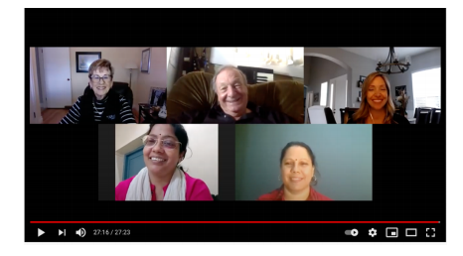
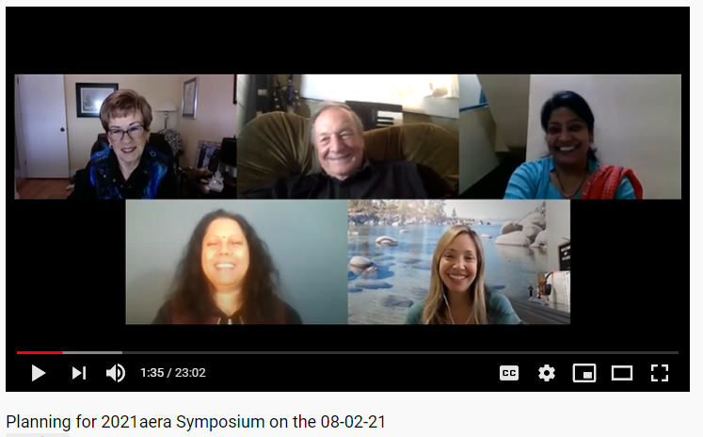
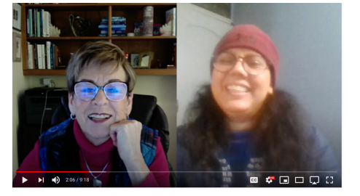
My untold story
Good to greater good

Slide 3
We influenced each other!
Dialogue
Joy
Care
Vulnerability

Slide 4
Accepting educational responsibility by living common educational values: A satvic framework
Parbati Dhungana
April 10, 2021

Slide 5
‘We’ made a difference!
Then
Now
Accepting Educational Responsibility: Breaking hegemony of measurability over mutuality – Nepal
R.Q. How can I create a mutual learning environment in my university class?
Accepting educational responsibility by living common educational values: A satvic framework
R. Q. How did I enhance goodness among facilitator/s and students of the graduate students?

Slide 6
Issue of my research
Passion for teaching, learning and assessing culture seems insufficient to promote satva (goodness) among facilitators and students particularly in the university classrooms.
According to the Eastern Wisdom Tradition, unlike tamasic (ignorant) and rajasic (passionate) people, satvic (good) people work for the common good.

Slide 7
3 Human attributes The Bhagavad Gita (14:5)
Satva
goodness
Rajas
(passion)
Tamas
(ignorance)
Liberation

Slide 8
Purposes
To enhance goodness among facilitators and students.
To accept educational responsibility in the university classroom context.

Slide 9
Theoretical referent
The use of my own living-educational-theory, “living love”, supported me to explore the notion of satva as the highest form of knowledge acquisition that holds the potentiality of accepting educational responsibility and thereby influencing me, my colleagues, students, and the university culture.

Slide 10
Methods
Self-study methodology
A participatory action research design
Dialogue method
Reflective journals, presentations, assignments, and Blog writing
Multimedia, SKYPE, and Zoom

Slide 11
Findings: A Satvic framework
A cluster of context-responsive approaches in the form of a satvic framework
The cluster includes
(1) voluntary participation,
(2) valuing an (everyday) sense of wonderment,
(3) respecting interdependence,
(4) enhancing the culture of inquiry (Delong, 2013), and
(5) adopting aesthetic/s inquiry.

Slide 12
Conclusion
Ignorance as vulnerability (a living value)
We may be the worst in one point of time but we can improve ourselves and make journey through tamas-rajas-satva being observant of our own attributes within the culture of inquiry
The journey from tamas to rajas to satva is not a linear but a cyclical process.
I added another meaning to my living-educational-value, ‘living love’ that is interconnectedness.

Slide 13
Significance
Vulnerability exerts living values like a moon on the tides and thereby develops a sense of interconnectedness in the local and global contexts.
Sustaining living-educational theory through shared space and values (transdisicplinary project; love, care and vulnerability)
Living-educational-theory praxis deepens living values as I added another meaning to ‘living love’ i.e. interconnectedness.

Slide 14
How we influenced each other
Delong: It seems we all are on our spiritual journey!
While I have mentored Parbati, we have learned together to understand cultural differences, to make explicit our values as explanatory principles and the nature of cultures of inquiry.
Jack: Parbati Dhungana’s shared her values that are grounded in her satvic framework with her focus on the attainment of goodness as the highest human attribute, form or state. Parbati Dhungana takes social responsibility and works for the common good within her Nepalise and global contexts.
Accepting educational responsibility by living common educational values: A satvic framework
Shivani: I was influenced by the way you put your loving and caring heart in flourishing humanity. I was inspired by your hard work and determination of disseminating your learning through writing.
Michelle: “The presence of vulnerability within my relationships forms a foundation in which I create a space for sharing and model open dialogue for my students.”
Reading Parbati’s definition of vulnerability as a synonym to the tamas attribute of ignorance created synaptic connections for me and allowed me to see the correlations in my own experiences in higher education between expressions of vulnerability and perceived weakness. Our discussions allow me to see my values from a new perspective and this has been a key avenue for personal growth

