Slide 1
Accepting Educational Responsibility in a USA context
Michelle Vaughan, Associate Professor, Department of Curriculum, Culture, and Educational Inquiry, Florida Atlantic University
Purpose of my contribution is to make connections between the individual journey of uncovering my own living theory to the work of building cultures of inquiry within the spheres of influence we each have around us

Slide 2
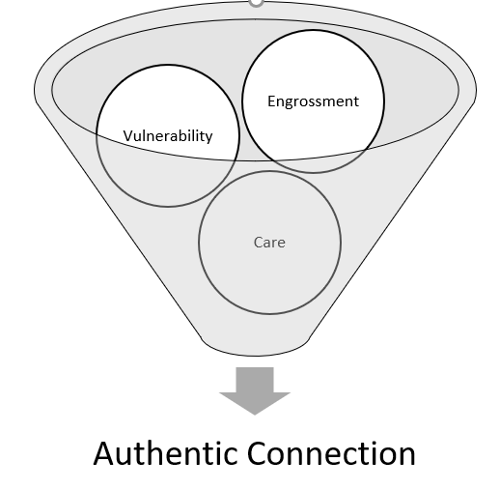
My own Living Theory

Slide 3
Cultures of Inquiry: What they are and how they are formed
Values of vulnerability, authentic connection, mindful questioning, and loving educational conversations
Spontaneous
Sustained
Micro
Macro

Slide 4
How can we individually and collectively demonstrate greater care about what happens in our society and in educational institutions?
Creating spaces for cultures of inquiry to grow and thrive demonstrates that we care about what happens within our educational institutions.
Facilitating cultures of inquiry where educators can explore, connect with, and align their teaching and research to their own core values demonstrates that we care about what happens in our society.
Are we teaching with love, vulnerability, and caring? Are we leading with love, vulnerability, and caring? And, lastly, are we researching from a place of love, vulnerability, and caring?
Please visit actionresearch.net for full copy of paper and contact information

